Slide 1
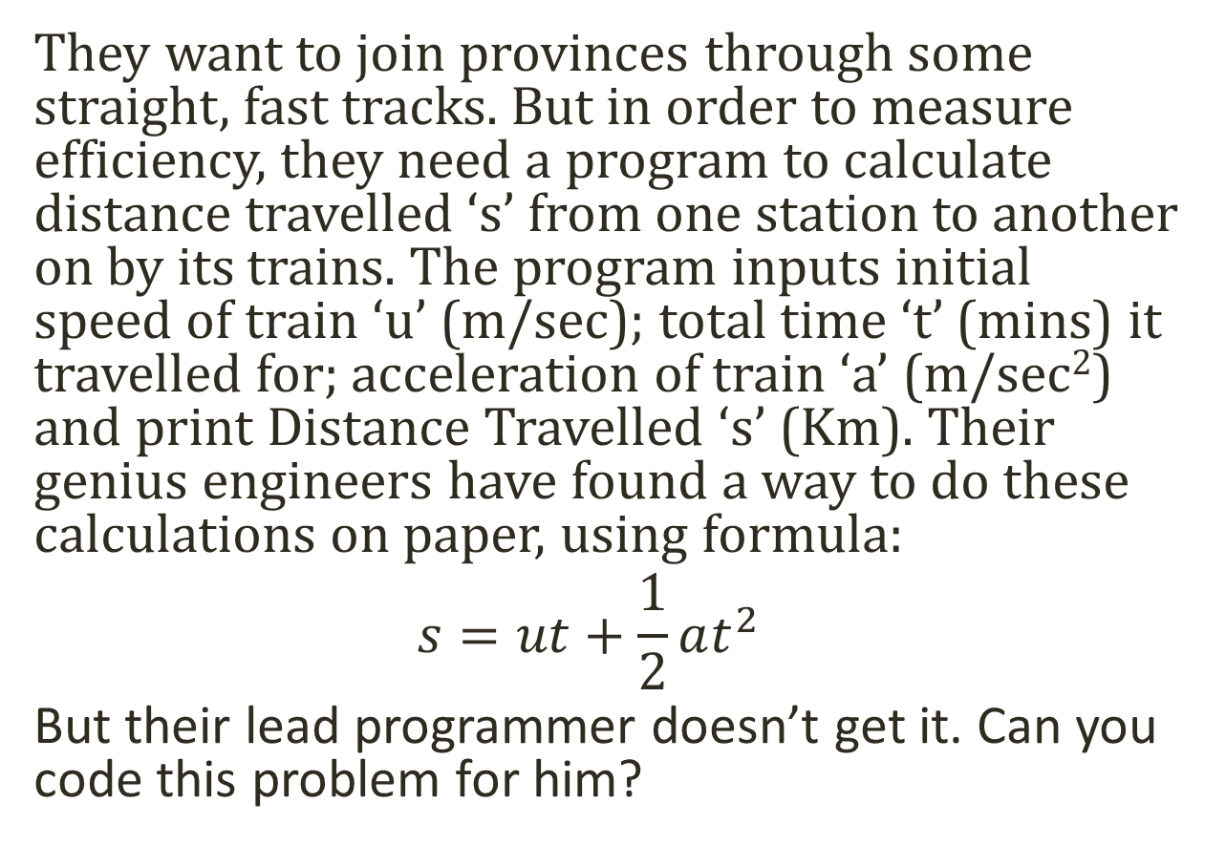
Pakistan Railway needs help!
They want to join provinces through some straight, fast tracks. But in order to measure efficiency, they need a program to calculate distance travelled ‘s’ from one station to another on by its trains. The program inputs initial speed of train ‘u’ (m/sec); total time ‘t’ (mins) it travelled for; acceleration of train ‘a’ (m/sec²) and print Distance Travelled ‘s’ (Km). Their genius engineers have found a way to do these calculations on paper, using formula:
$$s=ut+\frac{1}{2}at^{2}$$
But their lead programmer doesn’t get it. Can you code this problem for him?
Notes:
Time: 1h

